Slide 1
Python
Introduction to Programming
Comp07027
Lecture 12

Slide 2
Object Oriented Programming (OOP)
2
Constructors in Python
And Poly-morphism

Slide 3
Earlier …
… we introduced object oriented programming.
We saw how we could create a class, car, which was a blueprint for all instances of car we would want to create.
We chose the attributes registration, colour, make and model.

Slide 4
Constructors in Python
Constructor is a special method used to create and initialize an object of a class. On the other hand, a destructor is used to destroy the object.
Major constructor’s concepts to know….
How to create a constructor to initialize an object in Python
Different types of constructors

Slide 5
Purpose of constructor
In object-oriented programming, A constructor is a special method used to create and initialize an object of a class. This method is defined in the class.
The constructor is executed automatically at the time of object creation.
The primary use of a constructor is to declare and initialize data member/ instance variables of a class. The constructor contains a collection of statements (i.e., instructions) that executes at the time of object creation to initialize the attributes of an object.
For example, when we execute obj = Sample(), Python gets to know that obj is an object of class Sample and calls the constructor of that class to create an object.
Internally, the __new__ is the method that creates the object
And, using the __init__() method we can implement constructor to initialize the object.

Slide 6
Syntax of a constructor
def __init__(self): # body of the constructor
def: The keyword is used to define function.
__init__() Method: It is a reserved method. This method gets called as soon as an object of a class is instantiated.
self: The first argument self refers to the current object. It binds the instance to the __init__() method. It’s usually named self to follow the naming convention.

Slide 7
Create a Constructor in Python
In this example, we’ll create a Class Student with an instance variable student name. we’ll see how to use a constructor to initialize the student name at the time of object creation.
class Student: # constructor # initialize instance variable def __init__(self, name): print('Inside Constructor') self.name = name print('All variables initialized') # instance Method def show(self): print('Hello, my name is', self.name) # create object using constructor s1 = Student('Emma') s1.show()
Output
Inside Constructor
All variables initialized
Hello, my name is Emma

Slide 8
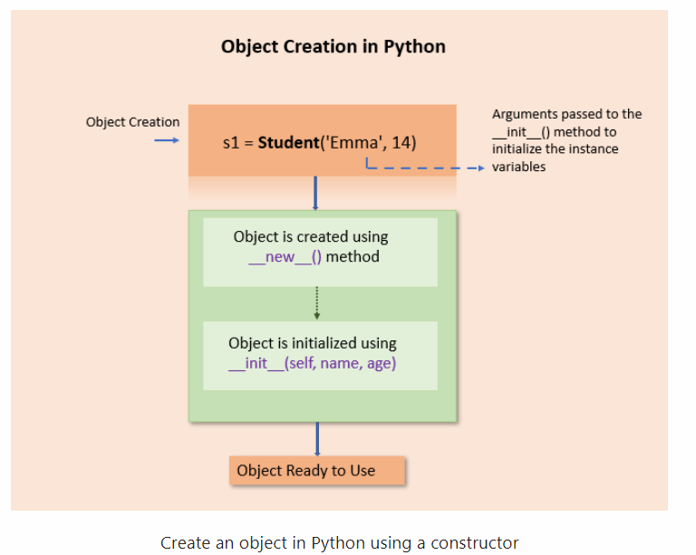
Create a Constructor in Python
In the above example, an object s1 is created using the constructor
While creating a Student object name is passed as an argument to the __init__() method to initialize the object.
Similarly, various objects of the Student class can be created by passing different names as arguments.

Slide 9
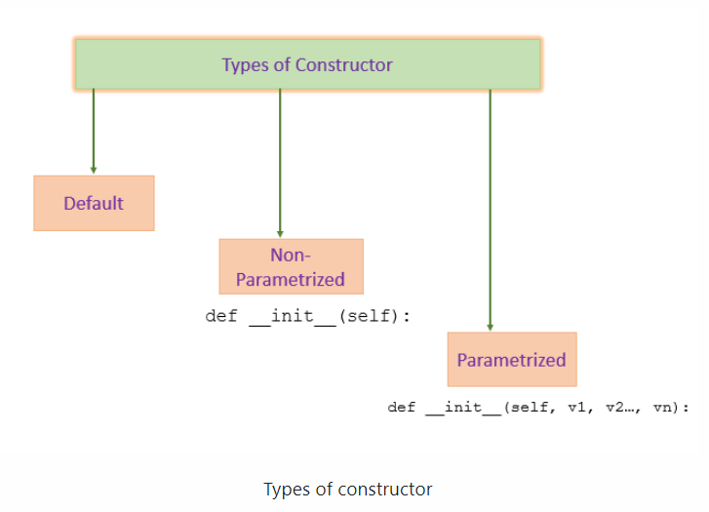
Types of Constructors
In Python, we have the following three types of constructors.
Default Constructor
Non-parametrized constructor
Parameterized constructor

Slide 10
Default Constructor
Python will provide a default constructor if no constructor is defined. Python adds a default constructor when we do not include the constructor in the class or forget to declare it. It does not perform any task but initializes the objects. It is an empty constructor without a body.
class Employee: def display(self): print('Inside Display') emp = Employee() emp.display()
The default constructor is not present in the source py file. It is inserted into the code during compilation if not exists. See the below image.
If you implement your constructor, then the default constructor will not be added.

Slide 11
Non-Parametrized Constructor
A constructor without any arguments is called a non-parameterized constructor. This type of constructor is used to initialize each object with default values.
This constructor doesn’t accept the arguments during object creation. Instead, it initializes every object with the same set of values.
class Company: # no-argument constructor def __init__(self): self.name = "Scotland Academy" self.address = "Wuxi Street" # a method for printing data members def show(self): print('Name:', self.name, 'Address:', self.address) # creating object of the class cmp = Company() # calling the instance method using the object cmp.show()

Slide 12
Parameterized Constructor
A constructor with defined parameters or arguments is called a parameterized constructor. We can pass different values to each object at the time of creation using a parameterized constructor.
The first parameter to constructor is self that is a reference to the being constructed, and the rest of the arguments are provided by the programmer. A parameterized constructor can have any number of arguments.
class Employee: # parameterized constructor def __init__(self, name, age, salary): self.name = name self.age = age self.salary = salary # display object def show(self): print(self.name, self.age, self.salary) # creating object of the Employee class emma = Employee('Emma', 23, 7500) emma.show() kelly = Employee('Kelly', 25, 8500) kelly.show()

Slide 13
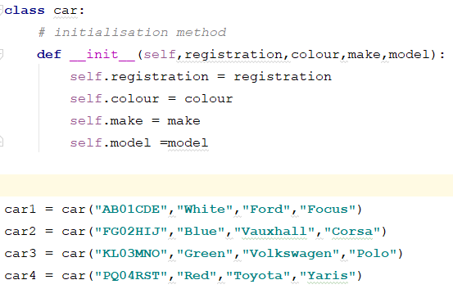
Earlier …
We created the class.
We also created four instances of the car class (car1, car2, car3, car4).

Slide 14
Earlier …
However, this is only half of the story.
Let’s look at another example.
We will create some classes and define their behaviours.

Slide 15
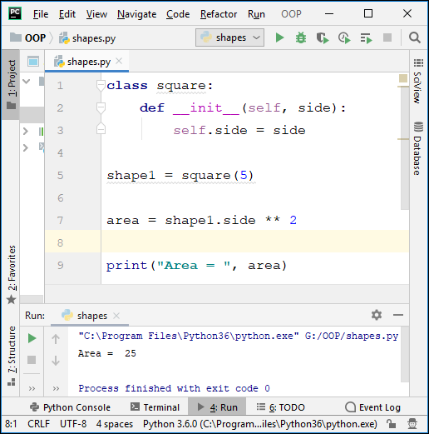
Creating a square
Here, we define a class called square which has a variable side.
We create a new square object with a side length of 5.
Then we calculate and display the area of the square.
However, is there a better way?

Slide 16
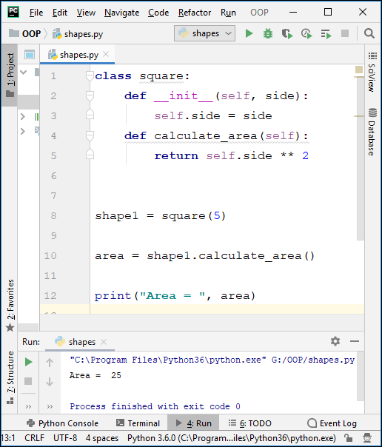
Methods
Now we define a method
calculate_area
which is wholly contained within the class square,
and accessed in the usual way by calling object.method i.e.
shape1.calculate_area()

Slide 17
Methods
So, every time we create an instance of the class square (object) we make calculate_area (method) automatically available using shape1.calculate_area()

Slide 18
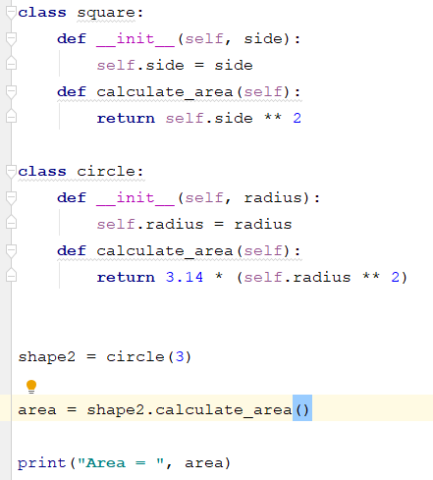
Adding a circle
Let’s add a class circle, with a method to calculate its area.
We create an instance of circle.
We calculate its area by calling its method.

Slide 19
Adding a circle
Notice:
The method to calculate the area in both classes has the same name.
The call to calculate the area is exactly the same for both classes except for the object before the dot.
All the work is done within the object.

Slide 20
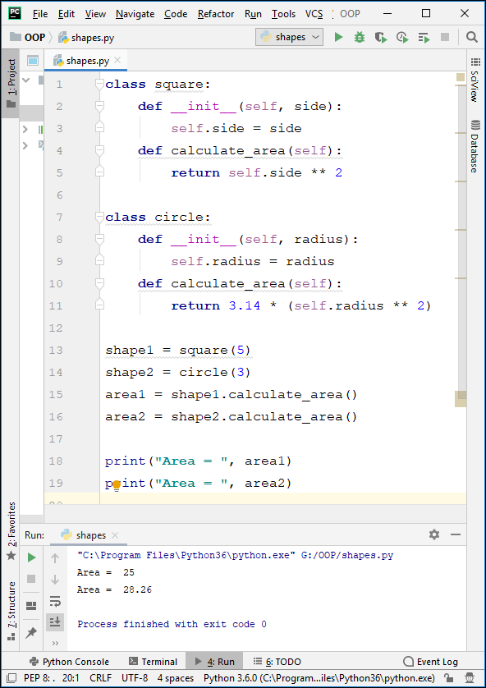
Methods
So, we can create one of each shape and calculate the area of each one, using its own calculate_area!!
Or …..
we can really up the ante ..

Slide 21
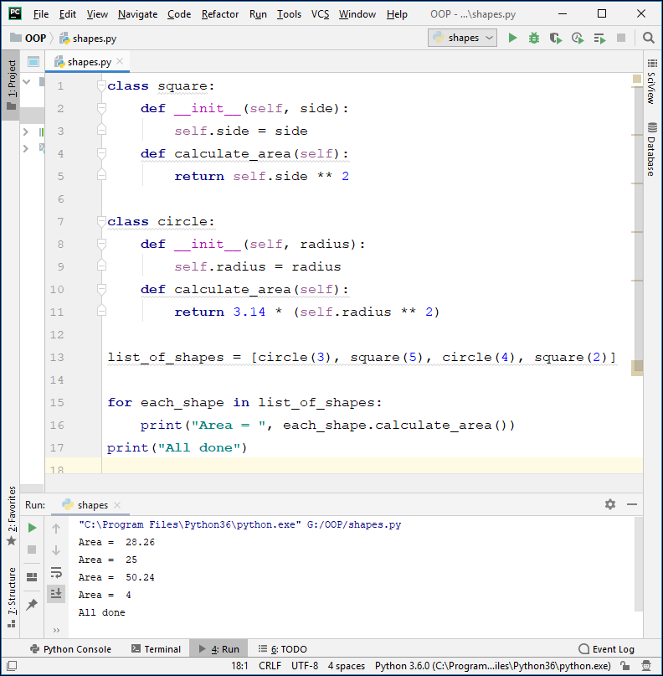
Methods
Let’s create some shapes, say two circles and two squares.
In fact, let’s create a list of shapes:
We know that lists in Python are very useful, so let’s use a loop to access each element in the list, one at a time.

Slide 24
Wow!!
We have stored different objects in a list,
and found all their areas in exactly the same way i.e.
by calling the method calculate_area
which has different definitions in each object.
All the hard work is done by the object itself!

Slide 25
Polymorphism
This ability to treat different types of object in the same way is an example of a powerful concept of OOP called polymorphism.

Slide 26
Questions??

